Slide 1
Basics in programming

Slide 2
Lectures 9.
Variable-length arguments in functions
Recursion in functions
Scope of variables
Mutable and Immutable data

Slide 3
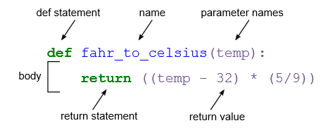
Functions in Python, recap

Slide 4
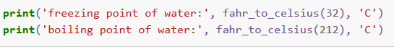
Functions in Python, recap

Slide 5
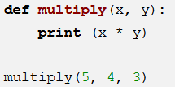
Functions in Python, recap
>> What error is produced?

Slide 6
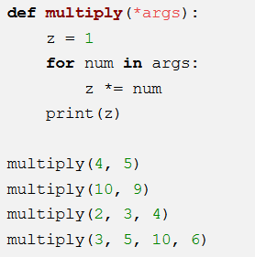
Variable length of arguments

Slide 7
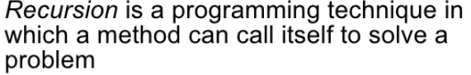
Recursion

Slide 8
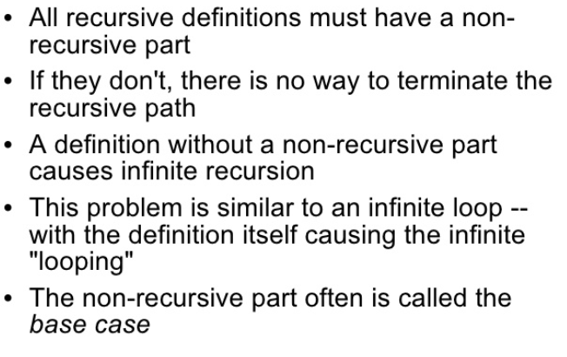
Recursion

Slide 9
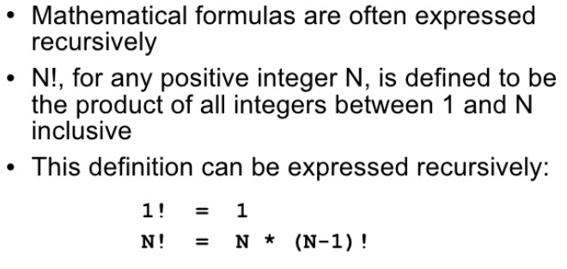
Recursion

Slide 10
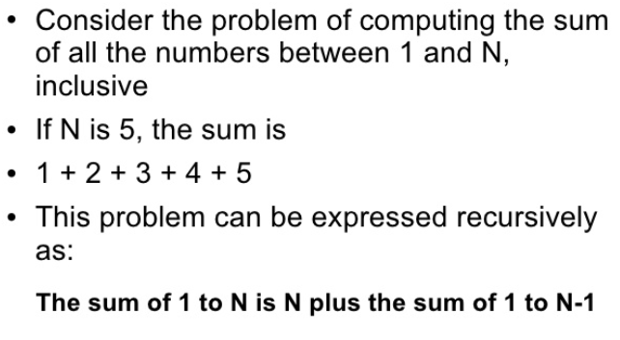
Recursion

Slide 11
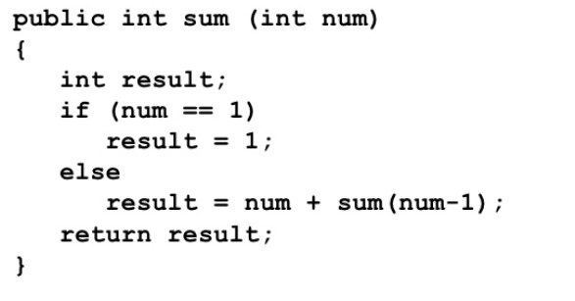
Recursion

Slide 12
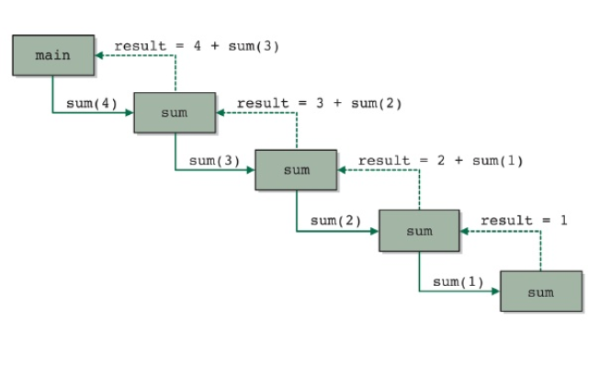
Recursion

Slide 13
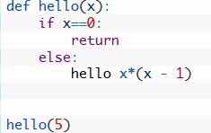
Recursion in Python

Slide 14
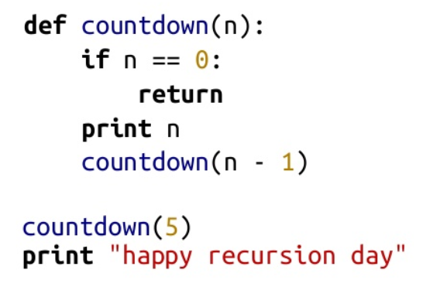
Recursion in Python

Slide 15
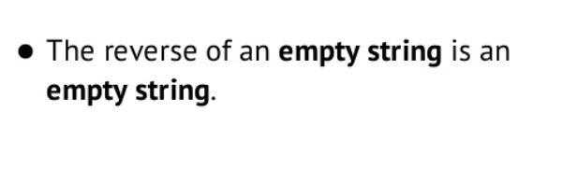
Recursion in Python
Reversing string with recursion:
- Base case:

Slide 16
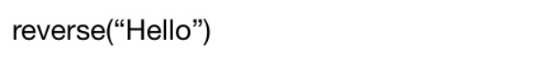
Recursion in Python
Reversing string with recursion:
- Recursive call:

Slide 17
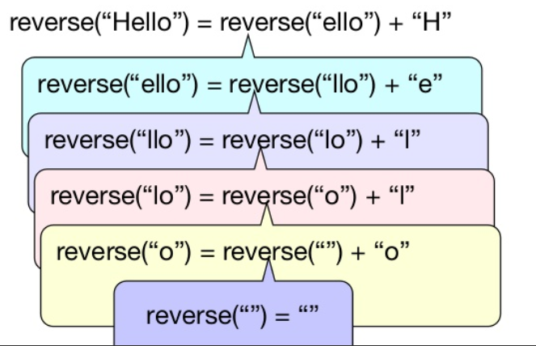
Recursion in Python
Reversing string with recursion:
- Recursive call:

Slide 18
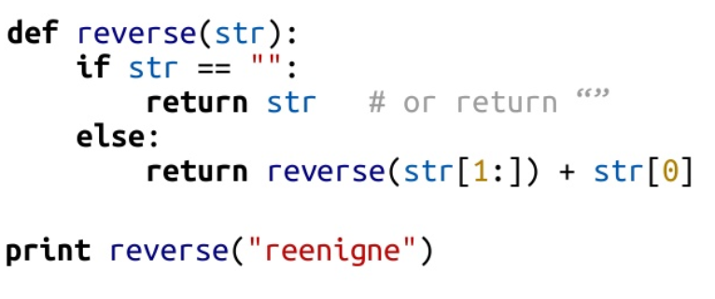
Recursion in Python
Reversing string with recursion:
- Recursive function:

Slide 19
Scope of Variables
When writing functions it is important to understand scope.
Scope refers to the area in a program where a variable is defined. Normally, a variable is defined after it has been assigned a value.
You cannot reference a variable until it has been assigned a value.

Slide 20
Scope of Variables
Local Scope
Enclosing Scope
Global Scope
Built-in Scope.

Slide 21
Scope of Variables
Local Scope
Local scope extends for the body of a function and refers to anything indented in the function definition.
Variables, including the parameter, that are defined in the body of a function are local to that function and cannot be accessed outside the function.
They are local variables.

Slide 22
Scope of Variables
Global Scope
A variable which is defined in the main body of a file is called a global variable.
It will be visible throughout the file, and also inside any file which imports that file.
Global variables can have unintended consequences because of their wide-ranging effects – that is why we should almost never use them. Only objects which are intended to be used globally, like functions and classes, should be put in the global namespace.

Slide 23
Scope of Variables
Built-in Scop
The final scope rule is the built-in scope. The built-in scope refers to those identifiers
that are built-in to Python. For instance, the len function can be used anywhere in a program
to find the length of a sequence.

Slide 24
Mutable Data and Functions
If function changes data of a variable that is passed to it as argument its called mutating.
Some variables are immutable and some mutable in functions.

Slide 25
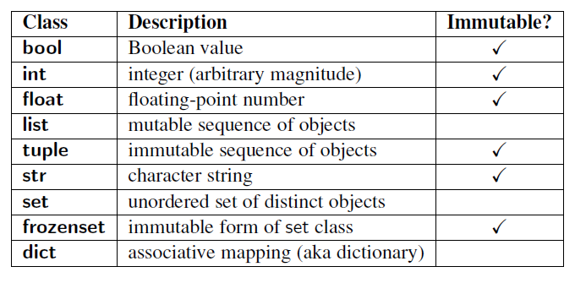
Mutable Data and Functions

Slide 26
Mutable Data and Functions
When a function is called that mutates one or more of its parameters, the calling code will see that the data has been mutated.
The mutation is not somehow undone when the function returns. Since strings, ints, floats, and bools are all immutable, this never comesup when passing arguments of these types.
But, again, lists are mutable, and a function may mutate a list

Slide 27
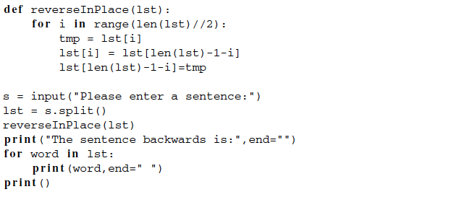
Mutable Data and Functions

Slide 28
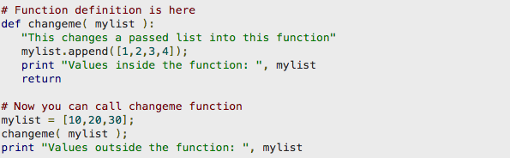
Mutable Data and Functions

Slide 29
Try mutating int

Slide 30
Mutable and Immutable objects
https://www.pythonforthelab.com/blog/mutable-and-immutable-objects/#mutable-and-immutable-data-types

Slide 31
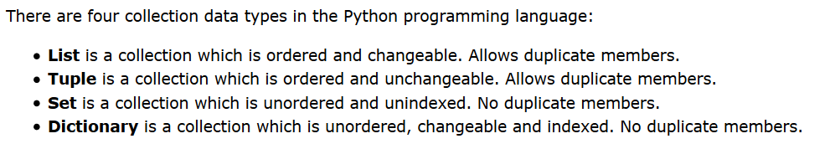
Tuple datatype

Slide 32
Tuple datatype
In Python programming, a tuple is similar to a list. The difference between the two is that we cannot change the elements of a tuple once it is assigned whereas in a list, elements can be changed.

Slide 33
Tuple datatype
-We generally use tuple for heterogeneous (different) datatypes and list for homogeneous (similar) datatypes.
-Since tuple are immutable, iterating through tuple is faster than with list. So there is a slight performance boost.
-Tuples that contain immutable elements can be used as key for a dictionary. With list, this is not possible.
-If you have data that doesn't change, implementing it as tuple will guarantee that it remains write-protected.

Slide 34
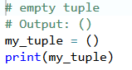
Tuple datatype

Slide 35
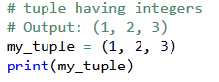
Tuple datatype

Slide 36
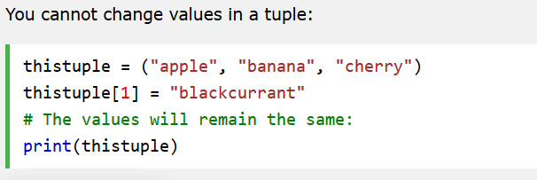
Tuple datatype

Slide 37
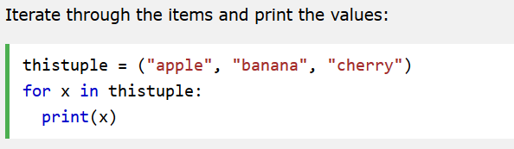
Tuple datatype

Slide 38
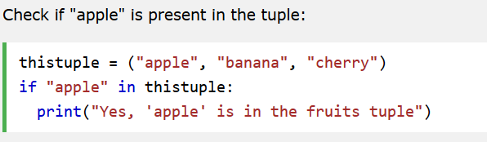
Tuple datatype

Slide 39
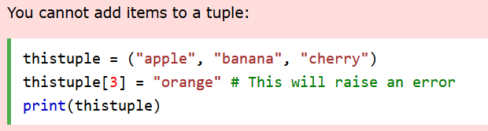
Tuple datatype

Slide 40
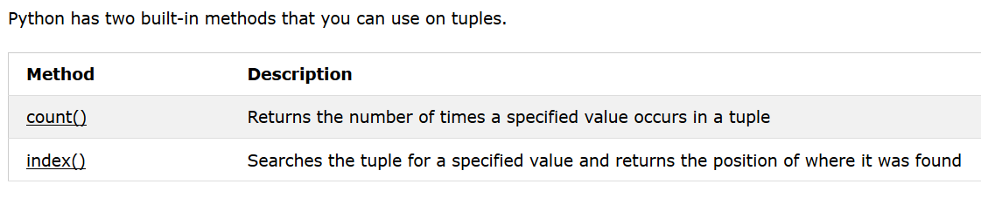
Tuple datatype

Slide 41
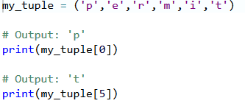
Tuple datatype

Slide 42
Tuple datatype
https://www.programiz.com/python-programming/tuple

Slide 43
Excercises 7.
Create program that uses recursion to calculate sum of digits that are given to recursive function. For example recursive(12345) would print 15
Create program that uses Tuple datatype as function return value. This function should ask user to enter his/her name and age and return it as Tuple object. In main program call this function in loop 5 times and print result

